Slide 1

“CareerVista”
A
Project report
Submitted
In partial fulfillment
For the award of the Degree of
Bachelor of Computer Application
In Department of IT & CS
Supervisor: Submitted By:
Dr. Avinash Panwar Anand Dubey
(Head of Department)
Department of IT & CS
University collage of science
Mohanlal Sukhadia University
Aug, 2024

Slide 2



CareerVista
An Job-Seeking Website
CareerVista
By: Anand Dubey

Slide 3


Overview
Introduction
01
Objectives
02
Requirement Specifications
03
Technology Used
04
Project Timeline
05
Database Structure
06
Future Scope
07
Conclusion
08
References
09
Our Team
10

Slide 4

Introduction
CareerVista is a platform that connects job seekers and recruiters, making job searching and hiring simple. It offers an easy way to find jobs or fill positions quickly and efficiently.
Job seekers can create profiles, upload resumes, apply for jobs, and track their applications. Recruiters can post jobs, review applications, and manage the hiring process all in one place.

Slide 5

OBJECTIVES
The main goal of CareerVista is to make the job-seeking and hiring process easier and more efficient for both job seekers and recruiters.
The platform aims to simplify job searches, enhance the job posting process, and improve overall application management. By offering user-friendly tools and features, CareerVista provides a seamless experience for everyone involved.
Easy Job Posting
Application Management
Profile Customization
Recruiters can quickly and easily create detailed job listings to attract the right candidates. The process is streamlined, allowing for efficient job posting and fast results.
Job seekers can apply for jobs and track their application status.
Recruiters can view and manage these applications, reviewing resumes and shortlisting candidates directly through the platform.
Both job seekers and recruiters can update their profiles to keep information accurate and current.

Slide 6

Requirement Specifications
CareerVista's requirements include hardware, software, and project needs for a smooth and secure user experience. It covers server and development hardware, essential software tools, and key aspects like performance, security, and scalability to ensure the platform runs efficiently and can grow.
Hardware Requirements
Software Requirements
Specific Requirments
Server Hardware: Multi-core processor (e.g., Intel Xeon), 16GB RAM, 500GB SSD, high-speed network for handling multiple requests and user traffic.
Development Workstations: Multi-core processor (e.g., Intel Core i5/i7), 8GB RAM minimum, 256GB SSD, and reliable internet connection for development.
Operating Systems: Linux-based server OS (e.g., Ubuntu Server), development across Windows, macOS, or Linux.
Database: MongoDB for flexible, scalable NoSQL storage.
Frameworks: Node.js and Express.js for backend, React.js for frontend UI, Git for version control.
Tools: VS Code, npm for package management, and Slack for communication and project management.
User Profiles: Create, update, and manage profiles for both job seekers and recruiters.
Performance: Ensure fast response times (under 2 seconds) and scalability to handle increasing data.
Security: Implement strong encryption, authentication, and authorization to protect user data and ensure privacy.

Slide 7

Front-End: React.js React.js builds the user interface with reusable components, a virtual DOM for fast updates, and React Router for smooth page navigation.
01
Technology Used
Back-End: Node.js Node.js powers the server-side operations with its non-blocking architecture and uses Express.js for efficient API and route management.
02
CareerVista utilizes the MERN stack to create a powerful and cohesive web application.
The MERN stack is a collection of powerful technologies—MongoDB, Express.js, React.js, and Node.js—that together create a comprehensive framework for building full-stack web applications.
Database: MongoDB MongoDB stores data in a flexible, document-oriented format and scales easily with large data volumes, supported by Mongoose for schema management.
03
Frameworks & Libraries Bootstrap and Material-UI enhance design with responsive and modern components, while jQuery simplifies event handling and interactions on the front end.
04

Slide 8
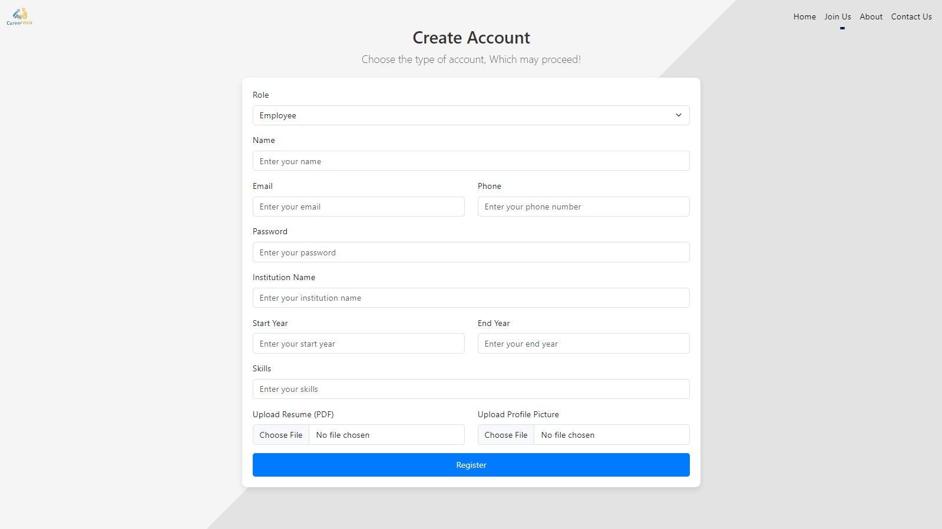
Project Modules
Create Account

Slide 9
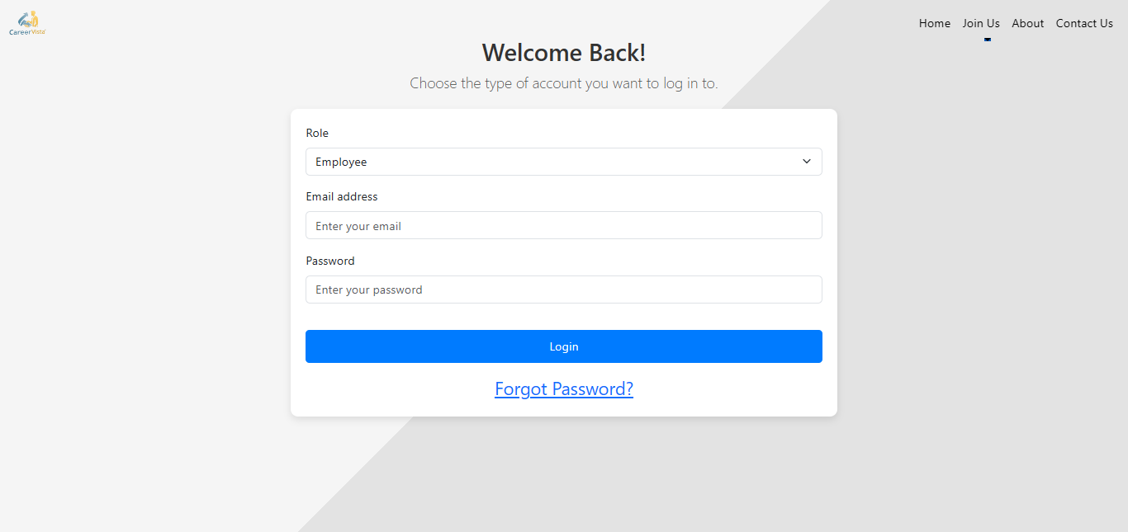
Project Modules
Login Account

Slide 10
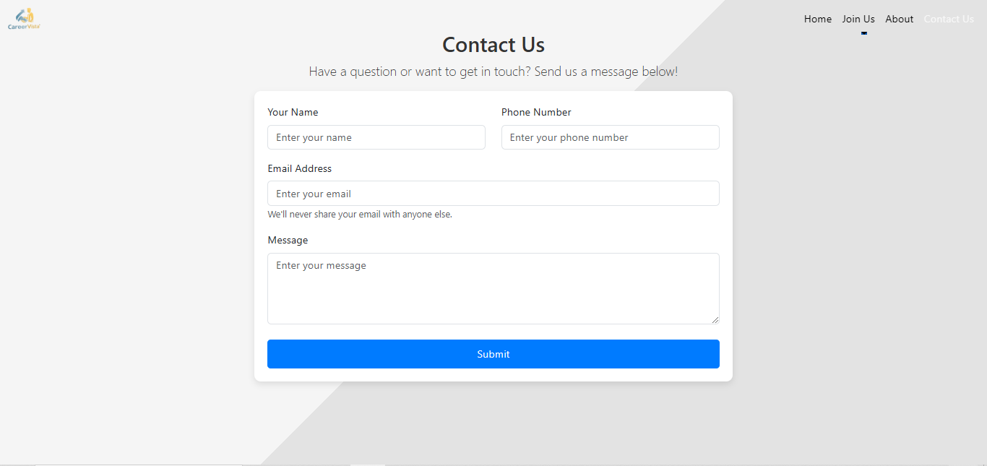
Project Modules
Contact Us

Slide 11
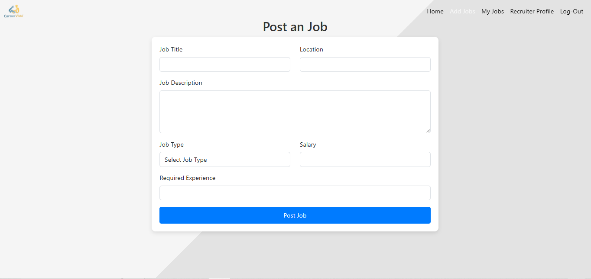
Recruiter Modules
Post Job

Slide 12
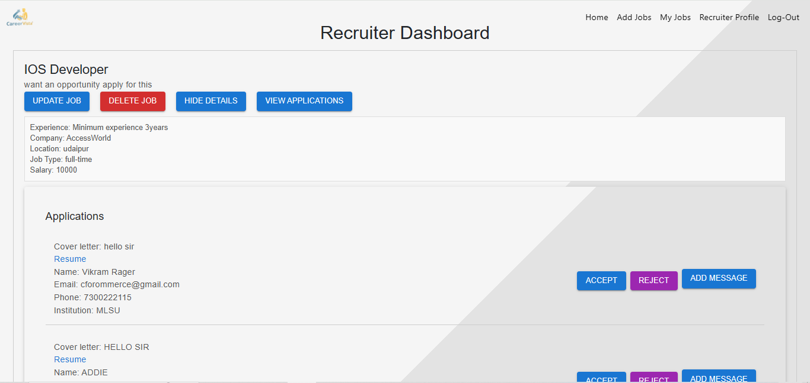
Recruiter Modules
My Jobs

Slide 13
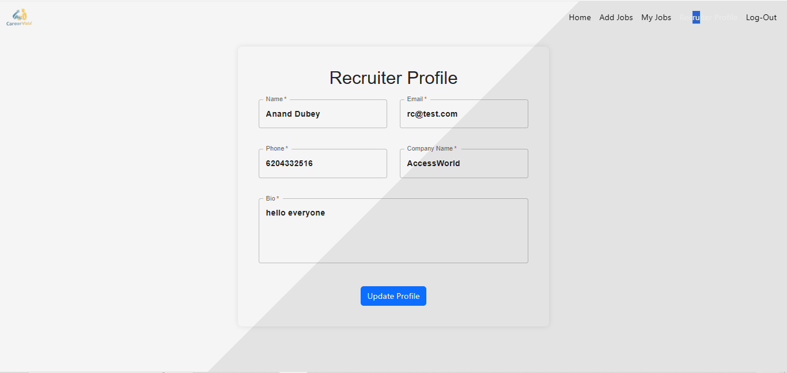
Recruiter Modules
Recruiter Profile

Slide 14
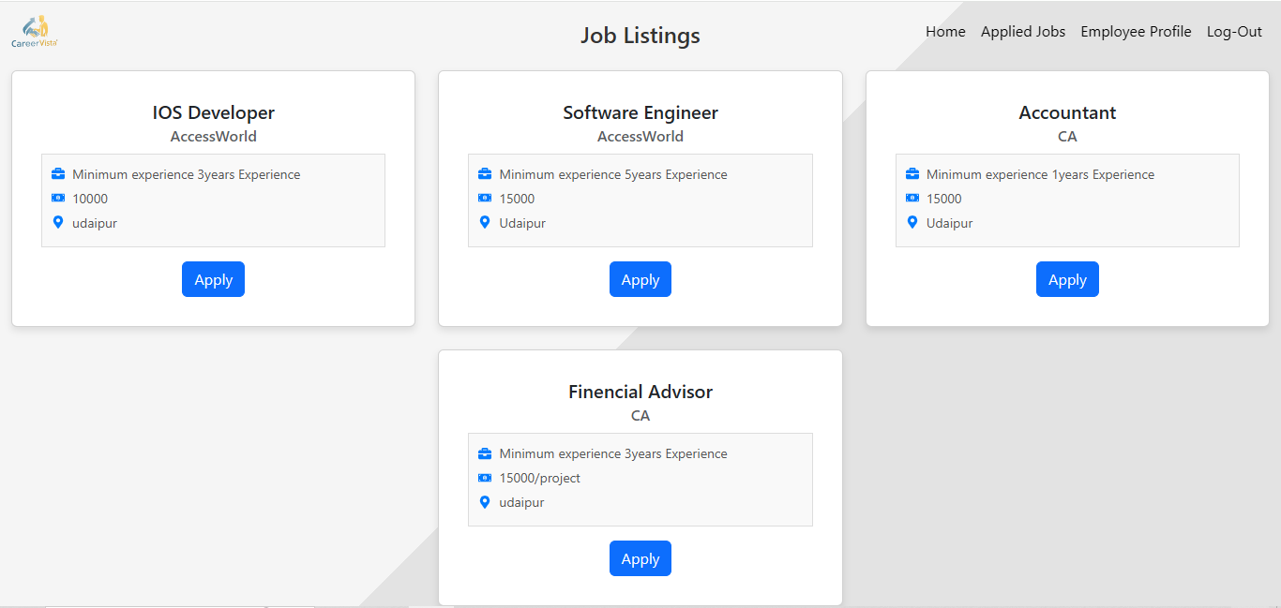
Employee Modules
Jobs List

Slide 15
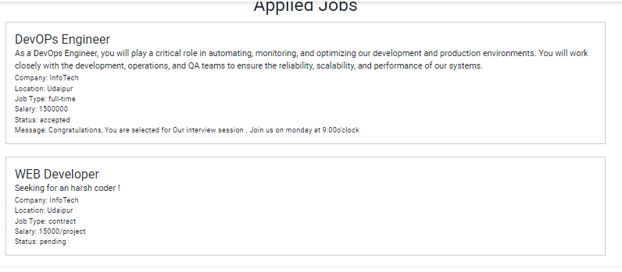
Employee Modules
Applied Jobs

Slide 16
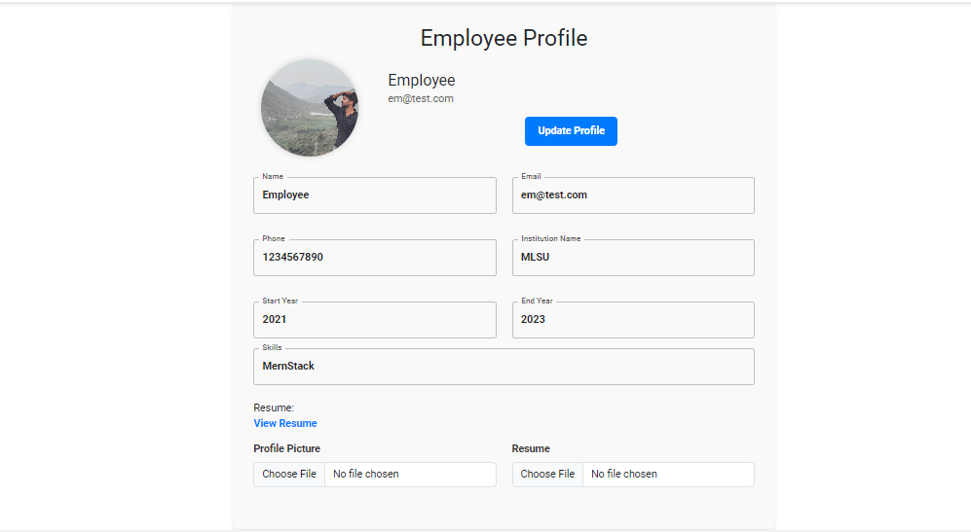
Employee Modules
Employee Profile

Slide 17
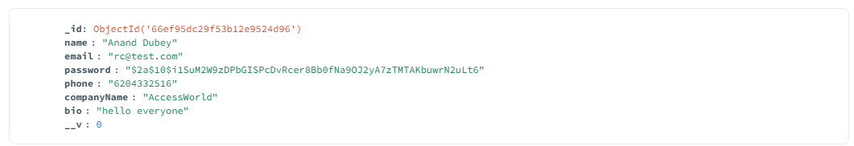
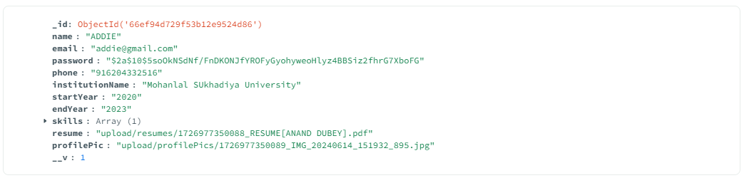
Database Structure
Recruiter
Employee

Slide 18
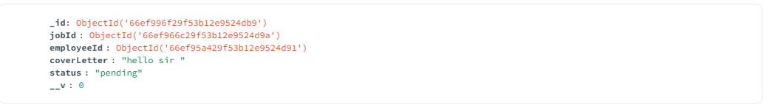
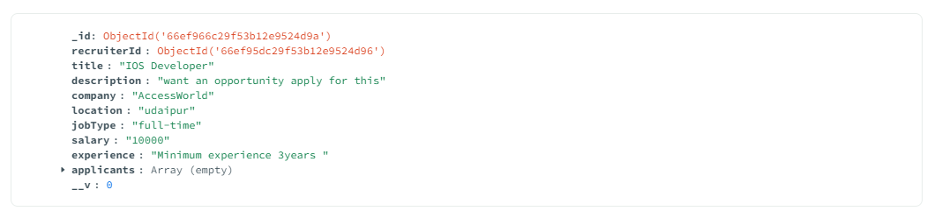
Database Structure
Recruiter
Employee

Slide 19
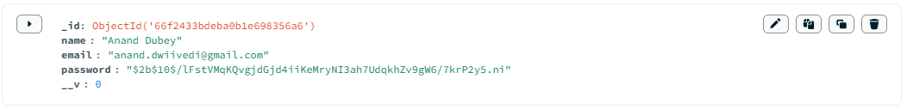
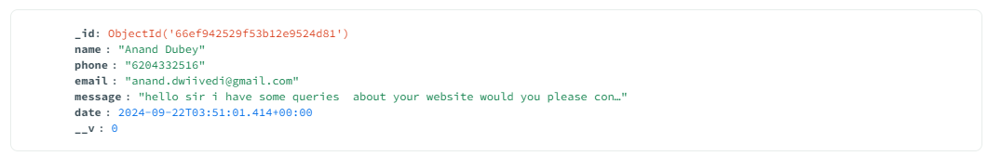
Database Structure
Admin
Contact Us
Subscribers

Slide 20
Future Scope
The future of CareerVista involves several exciting opportunities to enhance the platform, improve its performance, and expand its reach. This section provides an overview of potential improvements, scalability considerations, and plans for a mobile app version.
Advanced Filtering
Advanced Messaging
Admin
Panel
Location-Based: Search jobs by location or remote work.
Salary Range: Filter listings by salary expectations
.Job Type: Choose from full-time, part-time, contract, or freelance.
Skill Matching: Find jobs that align with your skills and qualifications.
Real-Time Chat: Add a real-time messaging feature to allow immediate communication between recruiters and job seekers.
Chat History: Keep a record of conversations for easy reference and continuity.
Notifications: Notify users of new messages or replies to ensure they stay updated.
User Management: View, edit, and manage user accounts for job seekers and recruiters.
Job Management: Oversee job postings, including review, approval, or removal of listings.
Analytics and Reporting: Generate reports and analyze data on user activity and job trends.

Slide 21
Conclusion
The development of CareerVista has been a comprehensive process, involving various stages from planning and design to implementation and testing. The following sections summarize the achievements, challenges faced, and lessons learned throughout the project.
Summery of Achievement
Challenges Faced
Lessons Learned
Developed a secure and scalable platform with job posting, application management, and profile features.
Enhanced user experience with a responsive design, real-time notifications, and email alerts.
Successfully integrated the MERN stack and conducted thorough testing for reliability.
Tackled integration issues between front-end and back-end, optimized Mongo DB, and ensured a responsive design across devices.
Addressed performance challenges, real-time feature optimization, and ensured robust security and error handling.
Clear requirement specifications and regular feedback are crucial.
Iterative development with continuous testing enhances product stability.
A user-focused, scalable, and modular design ensures long-term success.

Slide 22

References
React.js Documentation https://reactjs.org/docs/getting-started.html
Node.js Documentation https://nodejs.org/en/docs/
Express.js Documentation https://expressjs.com/en/starter/installing.html
MongoDB Documentation https://docs.mongodb.com/
Mongoose Documentation https://mongoosejs.com/docs/guide.html
Material-UI Documentation https://mui.com/getting-started/usage/
Bootstrap Documentation https://getbootstrap.com/docs/5.1/getting-started/introduction/
Git Documentation https://git-scm.com/doc
Postman Documentation https://learning.postman.com/docs/getting-started/introduction/

Slide 23
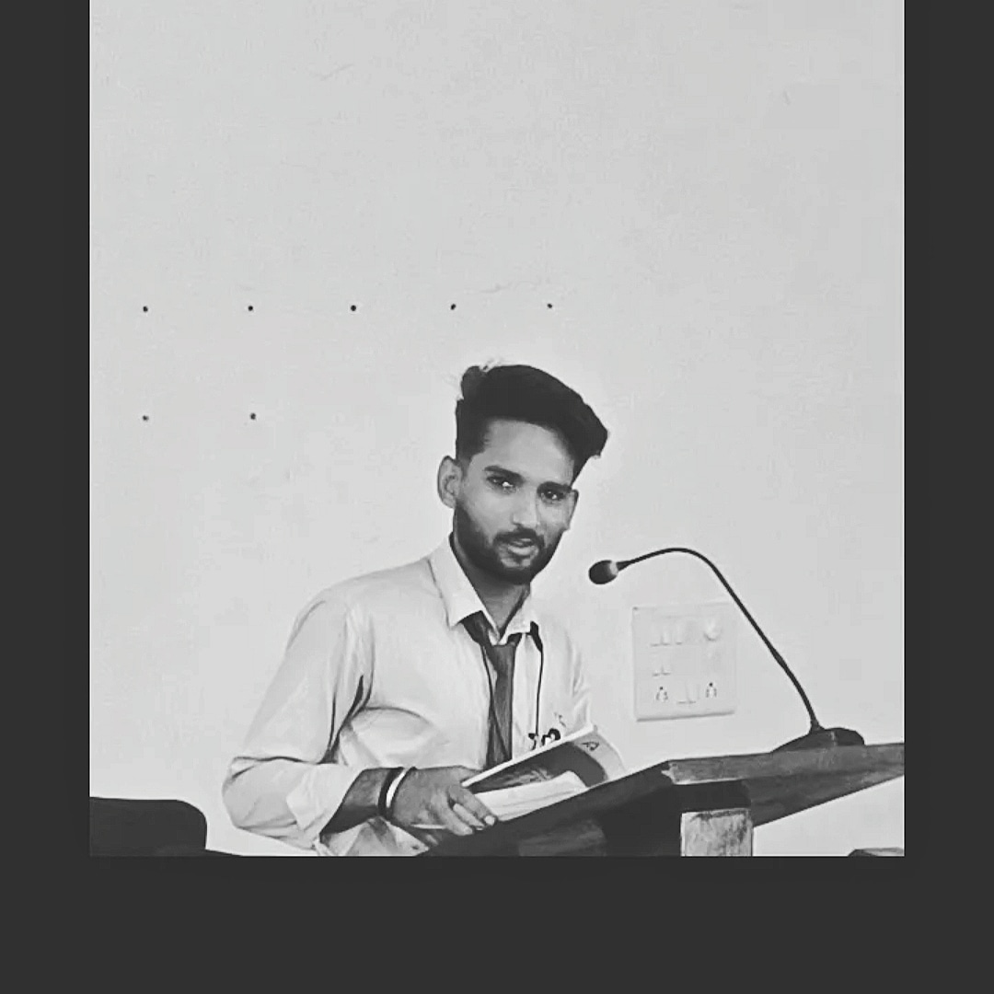

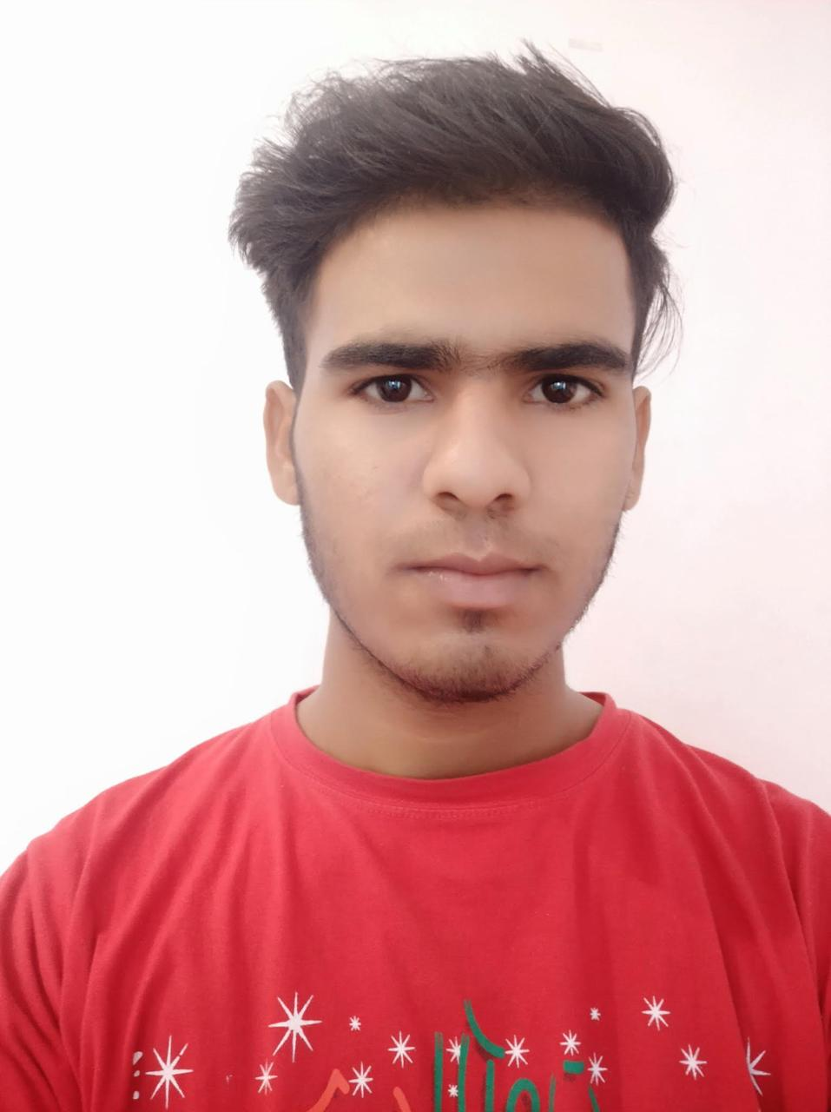
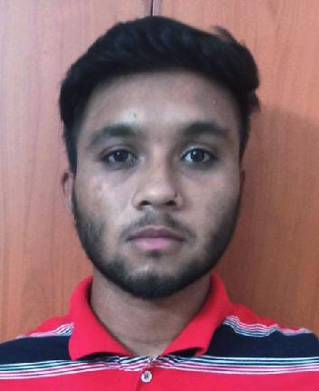
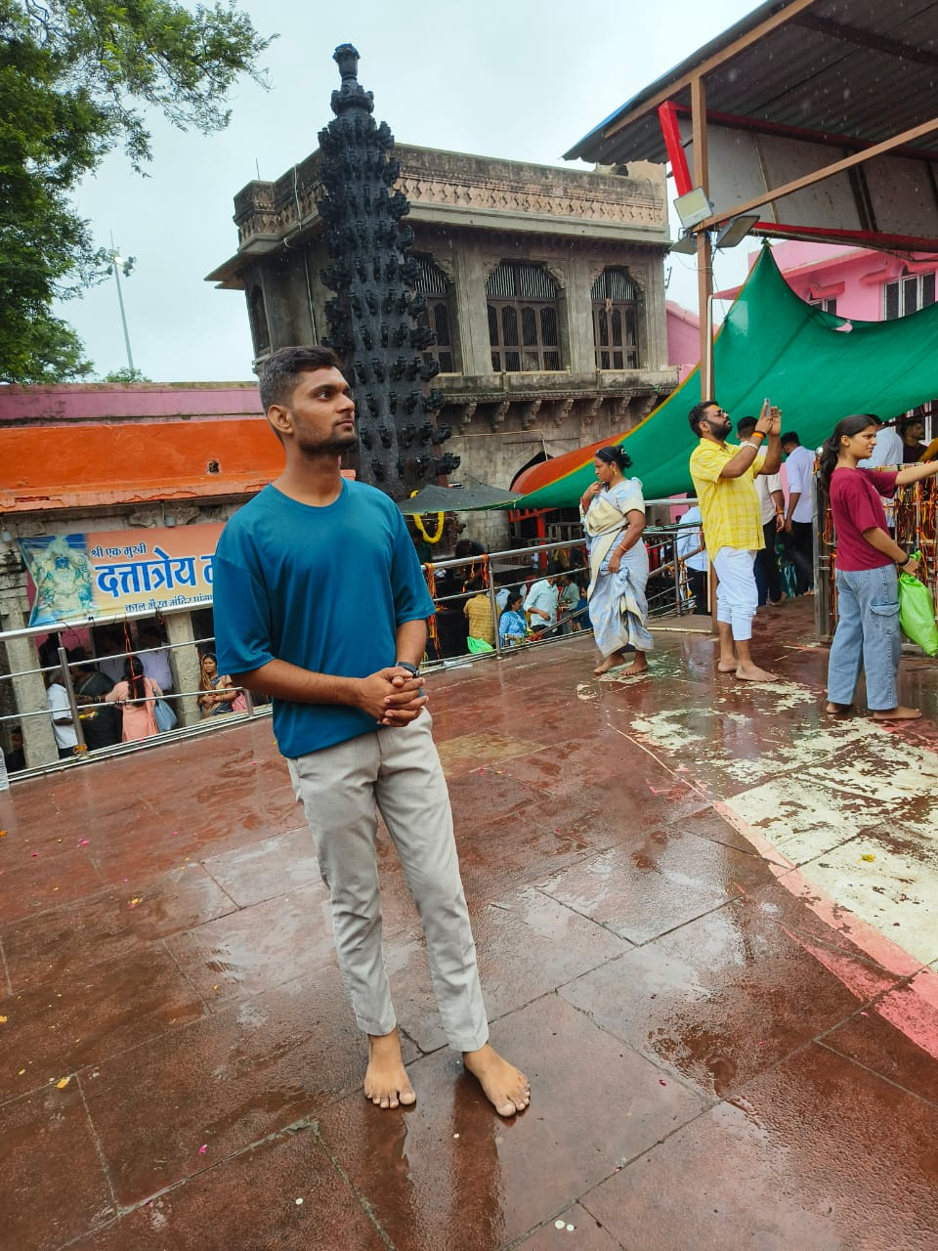
Our Team
Anand Dubey
Abhay Kotiya
Anurag Gothwal
Raunak Sharma
Akash Sharma
Team Leader
Developer
Developer
Developer
Developer

Slide 24

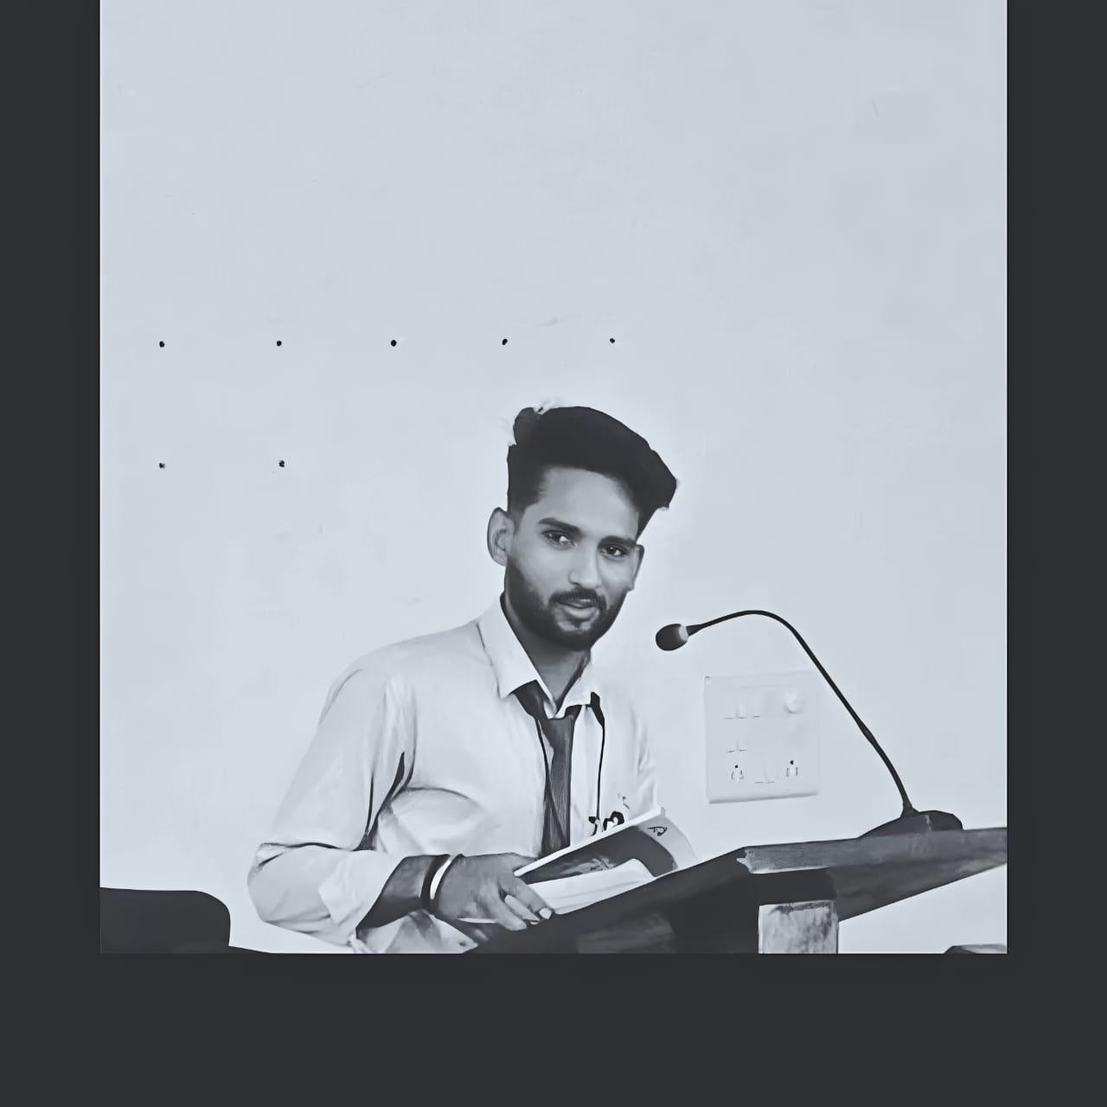



THANK YOU!
Anand Dubey
Project Leader
+91 62043-32516
www.careervista.com
INFORMATICS AND COMPUTATIONAL SCIENCE UNIVERSITY COLLEGE OF SCIENCE, MOHANLAL SUKHDIA UNIVERSITY, UDAIPUR

